Slide 1
Control Structures Intro, Selection

Slide 2
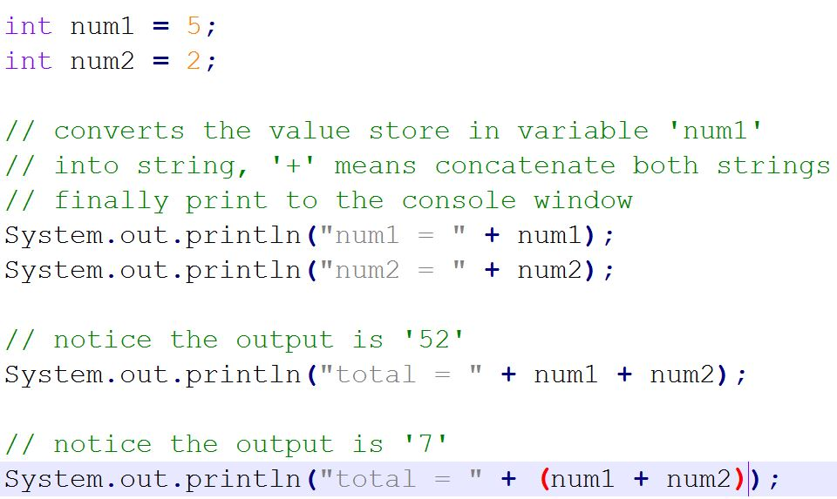
Review
Console output

Slide 3
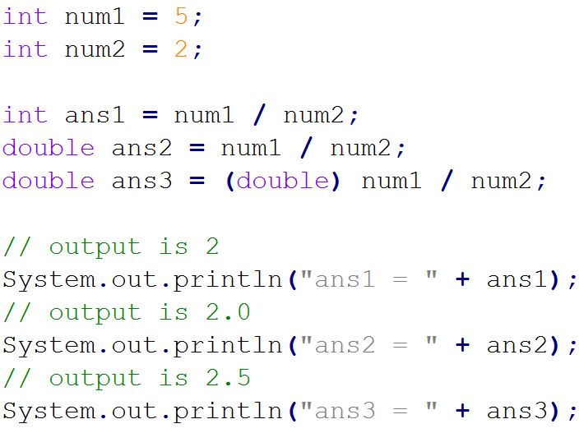
Type casting

Slide 4
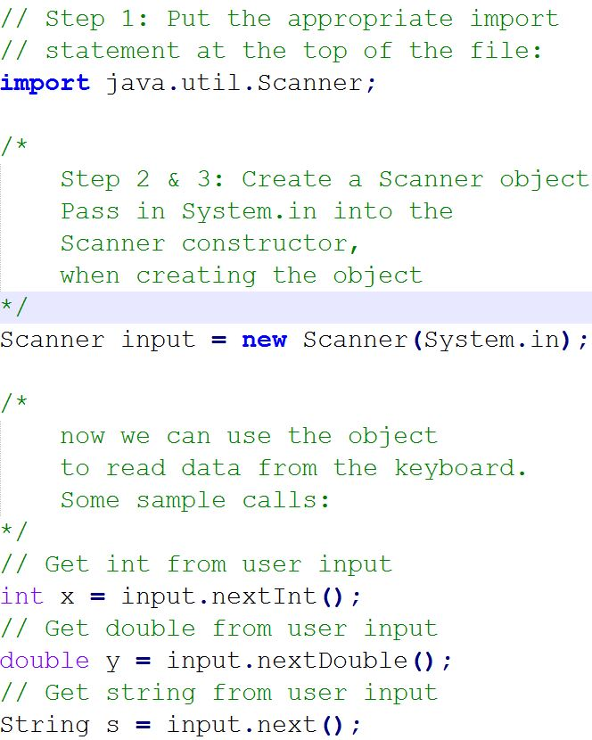
Console Input
use Scanner to read from standard input
System.in is an InputStream object that represents standard input
Put the appropriate import statement at the top of the file:
import java.util.Scanner;
Create a Scanner object
Pass in System.in into the Scanner constructor, when creating the object

Slide 5
print, println and printf
print() -- converts parameter to a string (if not already one) and prints it out
println() -- prints parameter, and also prints a newline after
printf -- works like in C programming. Formatted string, followed by parameters to "fill in the blanks"
Format of printf calls:
System.out.printf(format string, list of parameters);
%d specifies an integer
%c specifies a character
%s specifies a String
%f specifies a floating point type.
%.Nf N is the number of decimal places to print
Examples:
System.out.print("Hello World"); // no newline at the end
System.out.println("HelloWorld"); // adds newline at the end
int numStudents = 25; // int type variable
char letterGrade = 'A'; // char type variable
double gpa = 3.95; // double type variable
System.out.printf("There are %d students\n", numStudents);
System.out.printf("Bobby's course grade was %c, and his GPA is %f\n", letterGrade, gpa);
double gpa = 3.275;
double PI = 3.1415;
System.out.printf("gpa = %.2f", gpa); // outputs gpa = 3.28
System.out.printf("PI = %.3f", PI); // outputs PI = 3.142

Slide 6
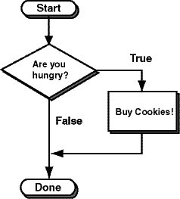
Single-block if Statements
The decision is about whether to buy cookies or just stroll on by. In the flow chart, start at the top, then follow the line to the question:
are you hungry?
The answer to the question is either true or false.
If the answer is true,
follow the line labeled true,
perform the action in the box
"buy cookies",
then follow the line to "done".
If the answer is false
follow the line labeled false to "done".

Slide 7
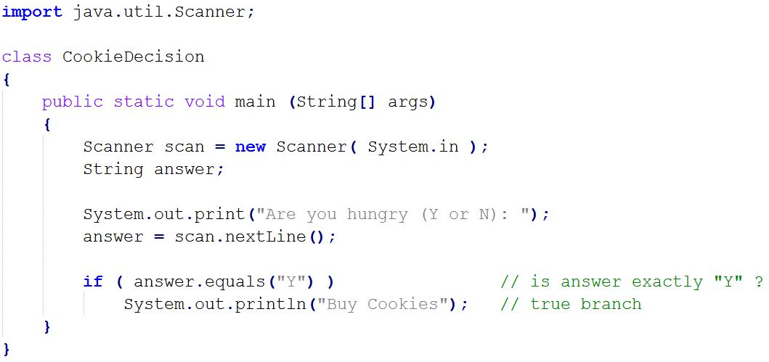

Slide 8
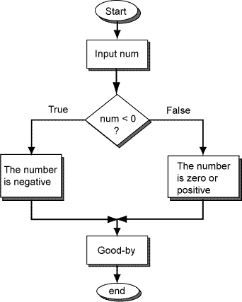
Decision Making
Number Tester
An integer may be negative, or not. If it is not negative, then it is positive or zero. Here is that idea expressed as a flow chart.
The diamond box shows a two-way decision. Either the false branch or the true branch is taken depending on whether num < 0 is true or false.

Slide 9
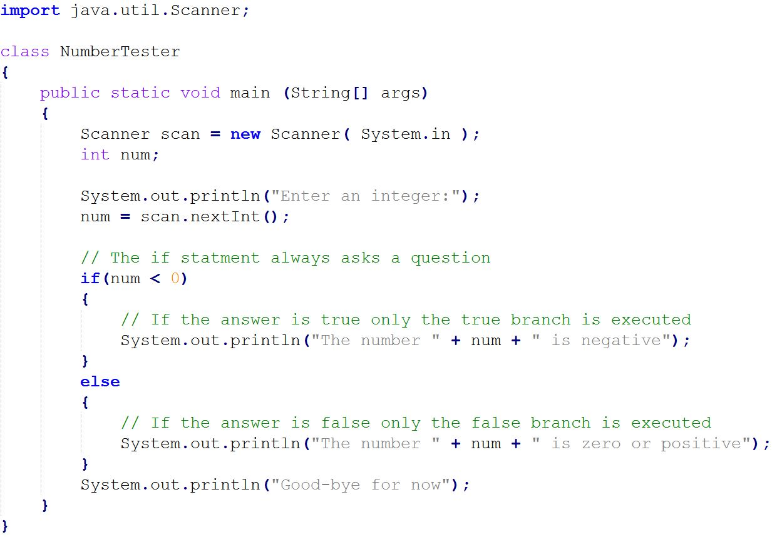

Slide 10
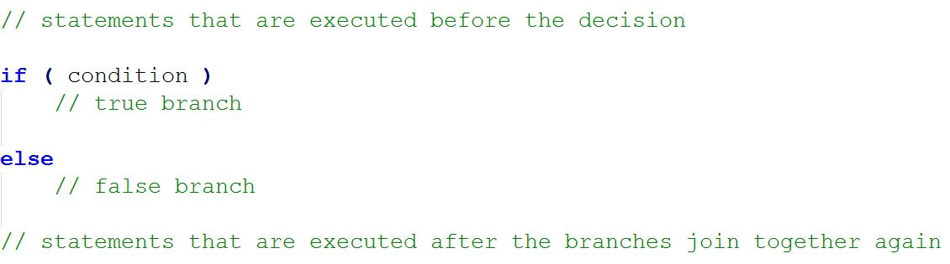
Outline of a Two-way Decision
Here is an outline of a two-way decision structure:
The condition can compare what is held in a variable to other values. You can use the comparisons <, >, and so on. (More about these later.) The first statement after the false branch will be executed no matter which branch is chosen.

Slide 11
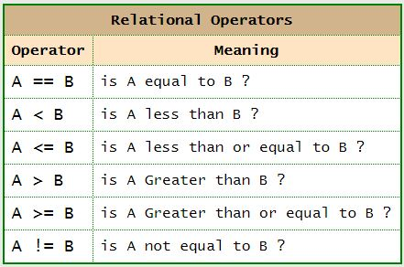
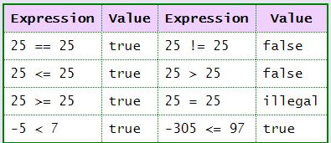
Boolean Expressions
A Boolean expression is an expression that evaluates either to be true or false.
Boolean expressions often compare numbers. A relational operator says how the numbers are compared.

Slide 12
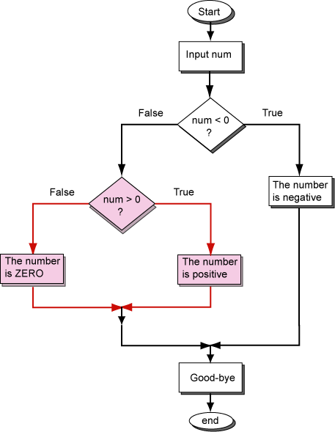
Three-way Decisions
We ran into this problem with a previous example program that divided integers into negative and non-negative. It really should pick one of three choices:
Negative: ... -3 -2 -1
Zero: 0
Positive: +1 +2 +3 ...
The flowchart shows how this works. One decision is nested inside the false branch of the first decision. A negative integer is correctly sorted out by the first decision. But a zero or positive integer goes through another decision to pick the correct category for it.

Slide 13
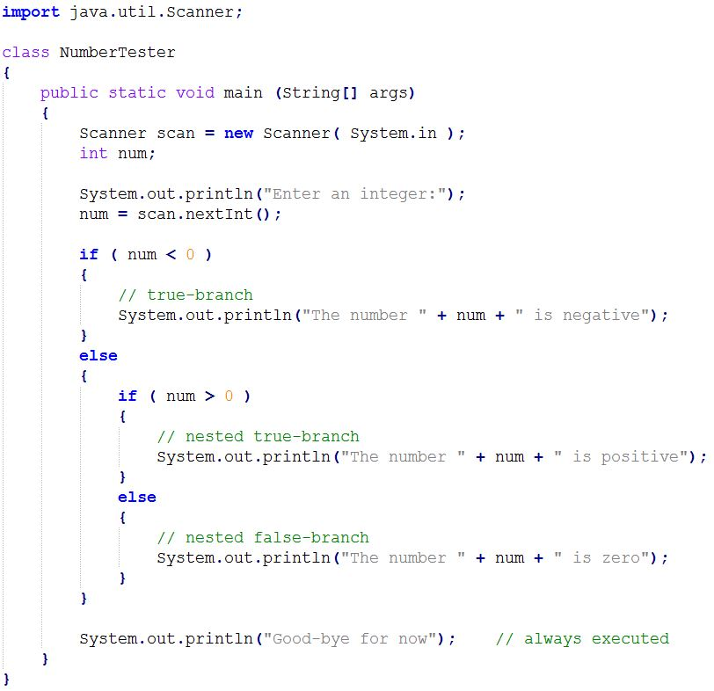

Slide 14
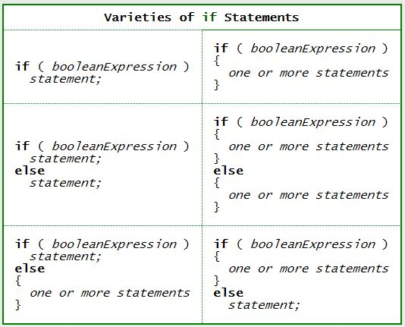
Varieties of if Statements

Slide 15

AND Operator
The and operator requires that both sides are true:
this side must be true && this side must be true
If both sides are true, the entire expression is true. If either side (or both) are false, the entire expression is false. && is a logical operator because it combines two true/false values into a single true/false value.
Here is what && does:
true && true = true
false && true = false
true && false = false
false && false = false

Slide 16
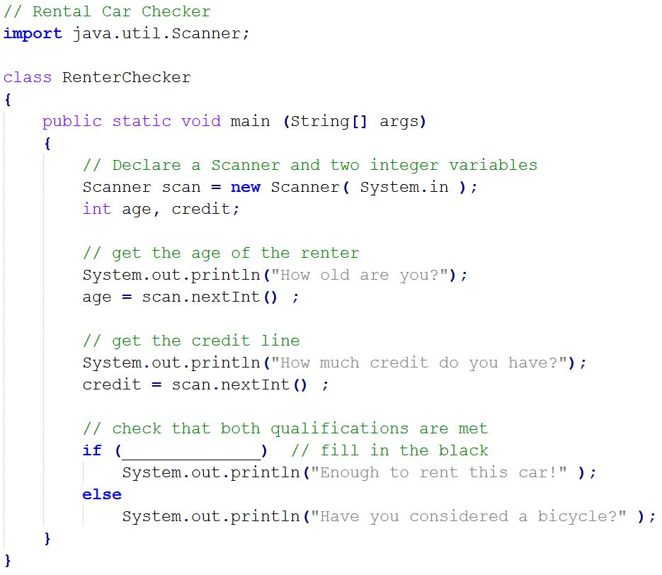
Car Rental Problem
A car rental agency wants a program to determine who can rent a car. The rules are:
A renter must be 21 years old or older.
AND
A renter must have a credit card with $10,000 or more of credit.

Slide 17
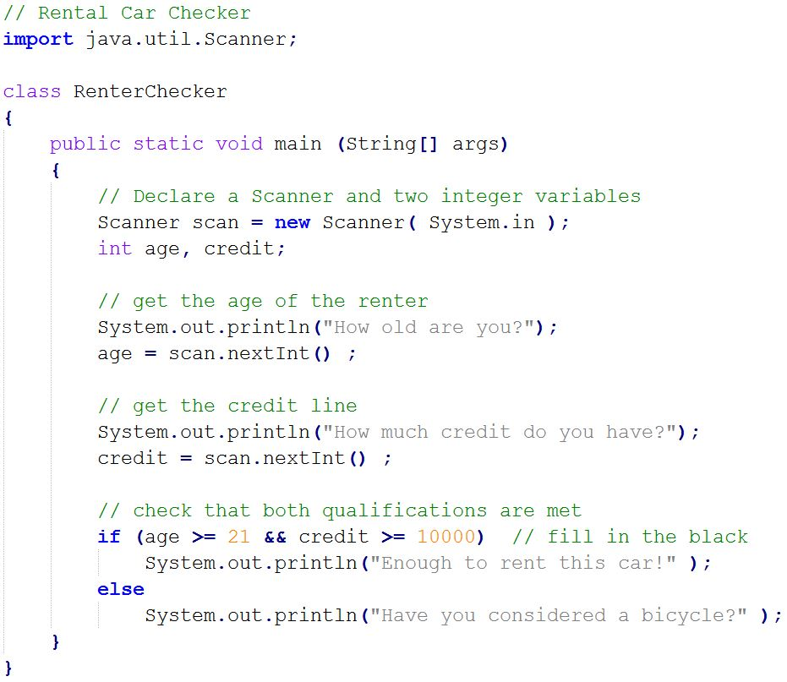
Car Rental Problem
A car rental agency wants a program to determine who can rent a car. The rules are:
A renter must be 21 years old or older.
AND
A renter must have a credit card with $10,000 or more of credit.

Slide 18
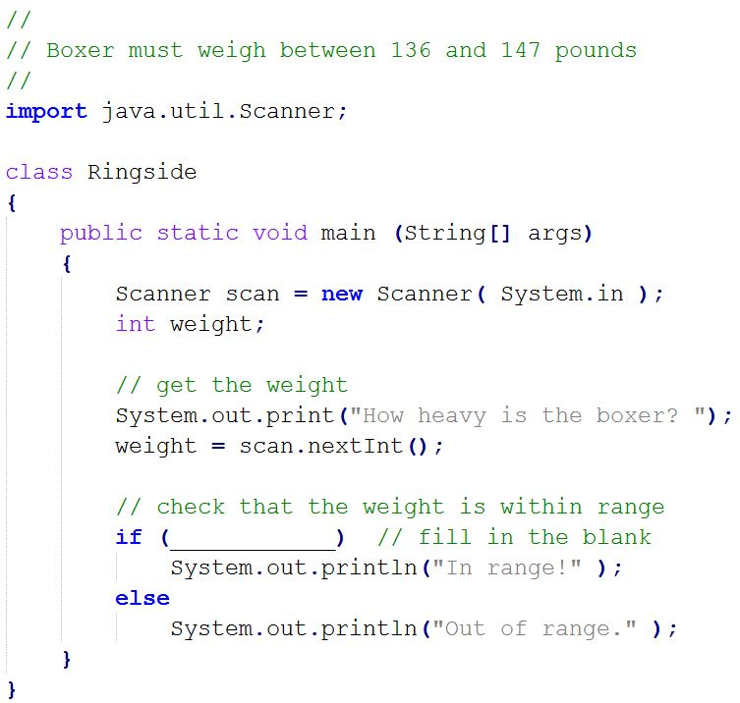
Range Testing
A welter weight boxer must weight between 136 and 147 pounds.
A boxer's weight is tested before each fight to be sure that he is within his weight category.
Here is a program that checks if a welter weight boxer's weight is within range:

Slide 19
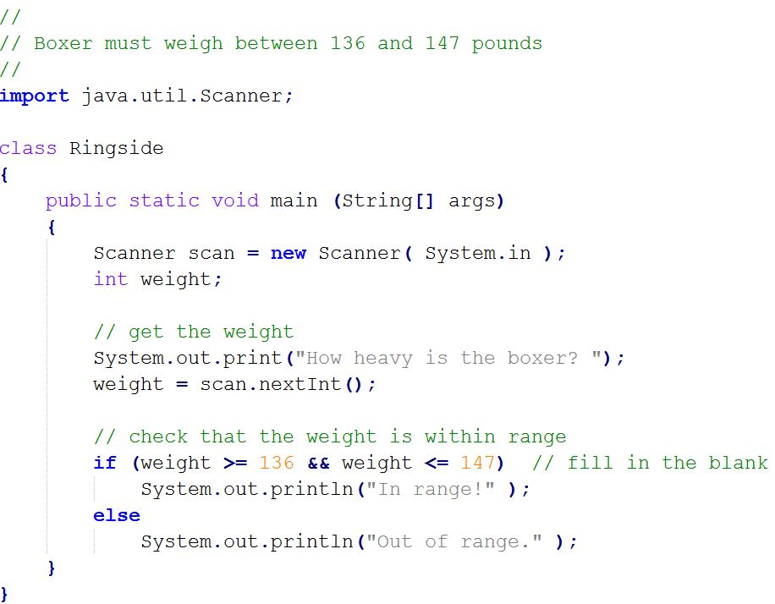
Range Testing
A welter weight boxer must weight between 136 and 147 pounds.
A boxer's weight is tested before each fight to be sure that he is within his weight category.
Here is a program that checks if a welter weight boxer's weight is within range:

Slide 20

Boolean Expressions with OR
The OR operator is used in a Boolean expression to check that there is at least one true. If both sides are true, the entire expression is true. If just one side is true, the entire expression is true. If both sides are false, the entire expression is false.
The OR operator is a logical operator because it combines two true/false values into a single true/false value.
Here is how || works:
true || true = true
false || true = true
true || false = true
false || false = false

Slide 21
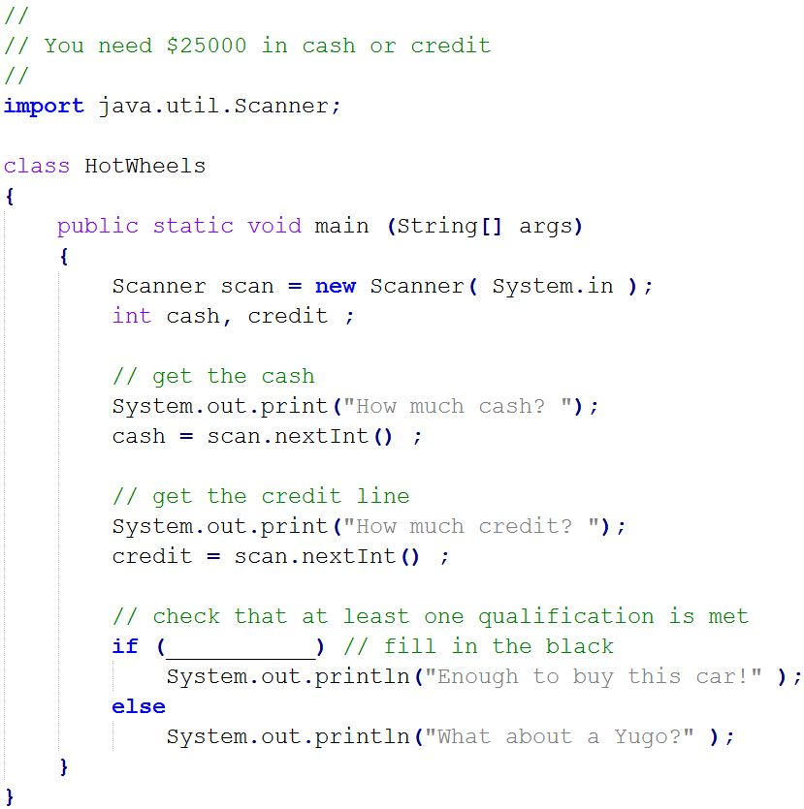
Car Purchase Program
A car dealer wants a program to determine who can buy a car. The rules are:
Buyer have $25,000 in cash
OR
Buyer have $25,000 in credit

Slide 22
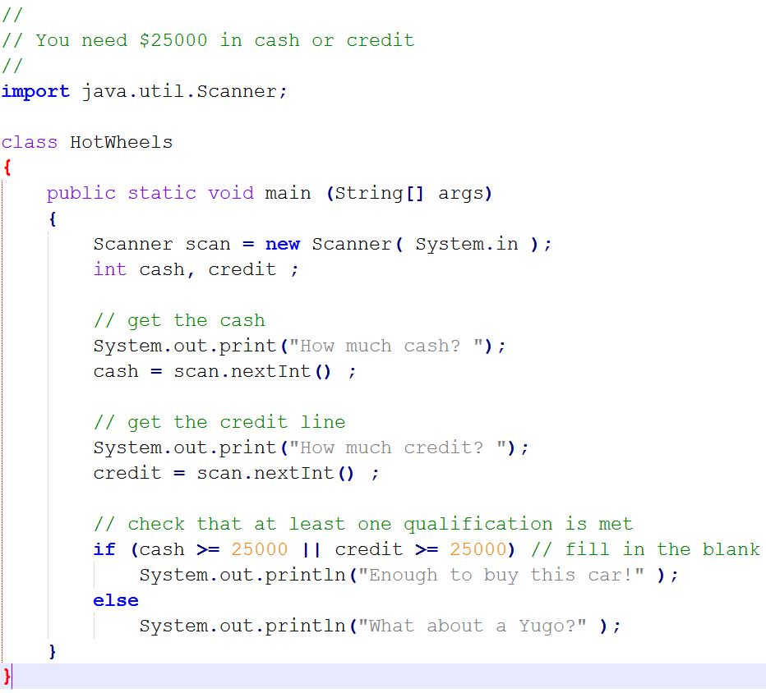
Car Purchase Program
A car dealer wants a program to determine who can buy a car. The rules are:
Buyer have at least $25,000 in cash
OR
Buyer have at least $25,000 in credit

Slide 23
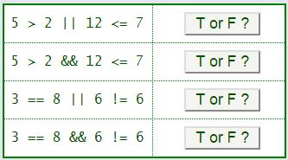
We have Boolean operators for combining expressions.
Again, these operators return true or false
!x // the NOT operator (negation) -- true if x is false
x && y // the AND operator -- true if both x and y are true
x || y // the OR operator -- true if either x or y (or both) are true
x ^ y // the exclusive or operator -- true if exactly one operand is true and one is false

Slide 24
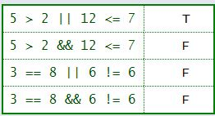
We have Boolean operators for combining expressions.
Again, these operators return true or false
!x // the NOT operator (negation) -- true if x is false
x && y // the AND operator -- true if both x and y are true
x || y // the OR operator -- true if either x or y (or both) are true
x ^ y // the exclusive or operator -- true if exactly one operand is true and one is false

